Slide 1


GRADUATE ADMISSION PREDICTION USING MACHINE LEARNING

Slide 2
FEATURES OF DATA SET
The dataset contains several parameters which are considered important during application for Masters Programs. The parameters included are
GRE SCORE (290TO340)
TOEFL SCORE (92 TO 120)
UNIVERSITY RATING (1 TO 5)
STATEMENT OF PURPOSE(1 TO 5)
LETTER OF RECOMMENDATION (1 TO 5)
UNDERGRADUATE CGPA (6.8 TO9.92)
RESEARCH EXPERIENCE (0 OR 1)
CHANCE OF ADMIT (0.34 TO 0.97)

Slide 3
various possible Approaches
Problem Statement:
Given the dataset,our objectve is to predict whether a student will get an admit or not.
So it means this is a binary classification problem
PROBLEM STAT
Problem Approaches:
Logistic Regression
Support Vector Machine
Gaussian Naive Bayes
Decision Tree Classification
Random Forest Classification
K Nearest Neighbors (KNN) Classification

Slide 4
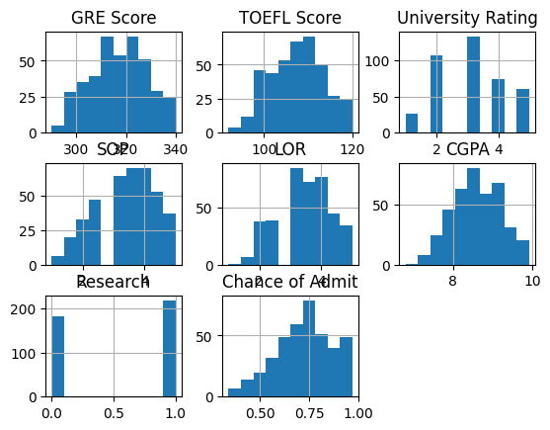
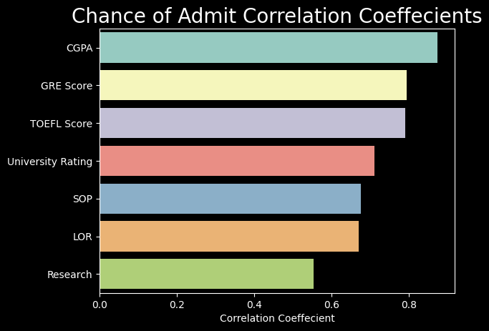
HISTOGRAM
OF DATASET
FINDING
CORERALTION

Slide 5

F1_SCORE
LOGISTIC REGRESSION: 0.85714285714285
SVC: 0.8571428571428527
RANDOM FORESTCLASSIFIER:0.857145257244
NAIVE BAYES CLASSIFERS:0.85714285714258
KNEIGHBORS CLASSIFIER:0.82354789641

Slide 6
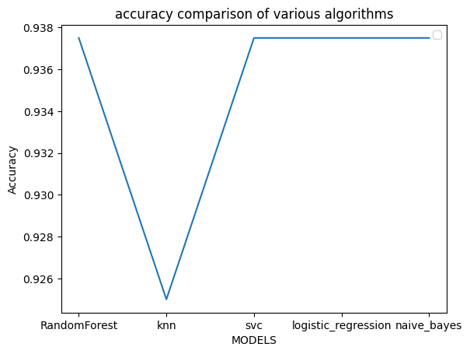

ACCURACY COMPARSION OF VARIOUS ALGORTHIMS

Slide 7

FUTURE SCOPE
Modifying the dataset to convert this problem into classification problem.
Currently the dataset is limited only predicting the chance of admission.
we plan to addd another class to the dataset which produces which college the student will be admitted based of academic perfomances.

Slide 8
Thank You!

